Slide 1




Exploratory Data Analysis
Project
Bank Churn Data
Group 4
Ayodeji Olawore
Michael Afolabi
Olufemi Abiodun

Slide 2
Exploratory Data Analysis
Project
Executive Summary
Project Problem Statement:
Acquiring a new customer can cost five times more than retaining an existing customer and increasing customer retention by 5% can increase profits from 25-95%, hence the strategic decision to dig into the customer churn data for our Bank, with the aim of identifying factors that enhanced customer’s account closure and propose ways to increase customer retention.
Findings:
The number of products subscribed to by customers has an inverse relationship with customer churn rate.
Customers that were inactive were 64% of customers that churned.
Customers over Senior citizens (65 years of age) have the lowest likelihood of churning (2%) followed by Adults aged 18years to 39 years at 34%, while Mid-life Adults were the highest at 64%.
The credit score grades are inversely related to churn rates, except for the lowest 2 grades that are interchanged i.e “Poor” the lowest credit rating has the second highest churn rate while “Fair” the second lowest rating has the highest churn rate.
Also France had the highest international customers churn rate, while females also generally had a higher churn rate.

Slide 3
Exploratory Data Analysis
Project
Data Description
Source Data information:
Data used for this project was sourced from www.kaggle.com and it consists of 14 columns and 1000 rows. The columns consist of 11 numeric classes inclusive of 3 binary columns, 2 categorical classes, and 1 text column containing surnames.
Data Cleaning process:
The data was cleaned by deleting the surname and Row number columns and changing the column name ”Geography” to “Location” for easier interpretation. The “customer age” column was modified to introduce a new categorical columns; “Customer Age Group” while the “Customer credit score” column was modified to create a new column called “Credit score grade” using the globally accepted FICO credit score grading.
All data cleaning, manipulation and visualization was done on python.

Slide 4
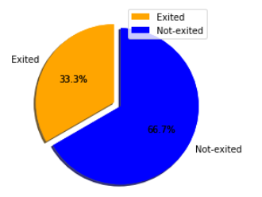
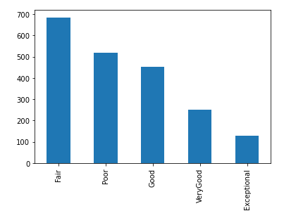
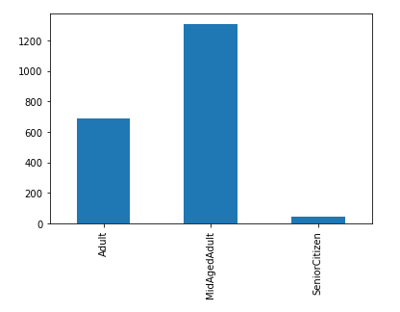
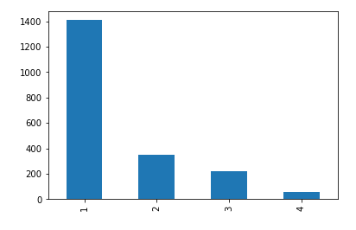
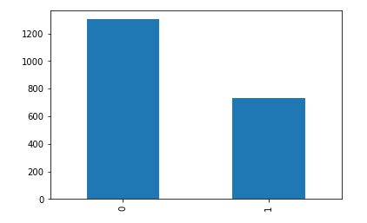
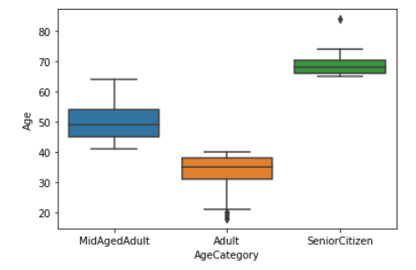
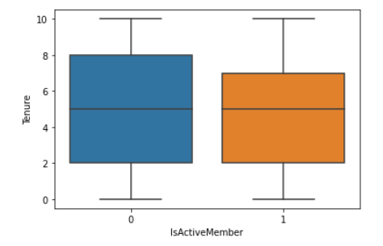
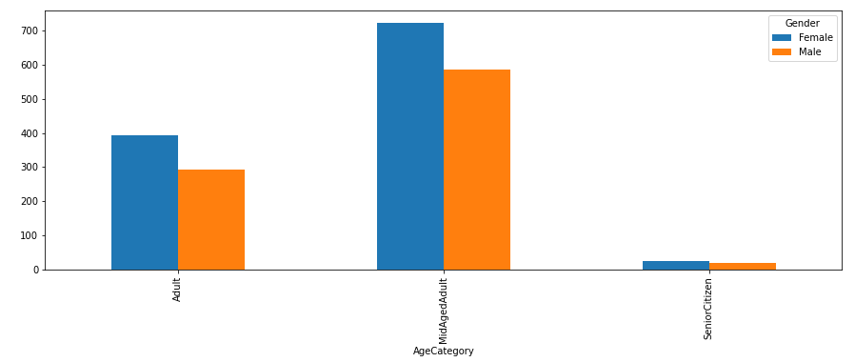
Data Visualization
Exploratory Data Analysis
Project
Churn rate by Credit
rate grading
Churn rate by Number of
products subscribed to
Churn rate by customer
Active status
Churn rate by
age group
Gender churn rates by
Age groups

Slide 5
Conclusion and Recommendations
Exploratory Data Analysis
Project
Since it is established that customers with higher number of subscribed bank products churned less, it is imperative to increase enlightening of existing customers to unsubscribed bank products, to ensure that more customers sign up for multiple products of the bank.
Also, since the majority of customers that churned are inactive members, hence there is a need to engage inactive members to sign up for bank products.
There is also a need to retain more Mid-life Adults who have the highest churn rate of 64% as they will churn less as they cross the 65 years line. It may be necessary to ensure they have more products tailored to meets their peculiarities.
The credit score grades are inversely related to churn rates, except for the lowest 2 grades that are interchanged i.e “Poor” the lowest credit rating has the second highest churn rate while “Fair” the second lowest rating has the highest churn rate.
There are more women in the ‘high-churn’ age categories, hence bank product development efforts can be geared towards the feminine oriented industries such as fashion and cosmetics entrepreneurs funds or payment packages with already existing notable brands in these industries. This can also be applied in France.
Thank You!

